Slide 2
MN State HS Math League
Conducting Online Meets
Part Two
Verifying Answers

Slide 3
Once team is done with Individual events
and team test, you must verify grades
Verify Grades
Go to Meet Op -> Grade Online Taken Events
May be started as soon as some students have finished their first event
Individual Events
Select each student and verify auto-scoring was correct.
Mark team done with event
Team Event
Select scoring team and alternates and verify auto-scoring
Mark team done with meet

Slide 4
Once team is done with Individual events
and team test, you must verify grades
Go to Meet Op -> Grade Online Taken Events

Slide 5
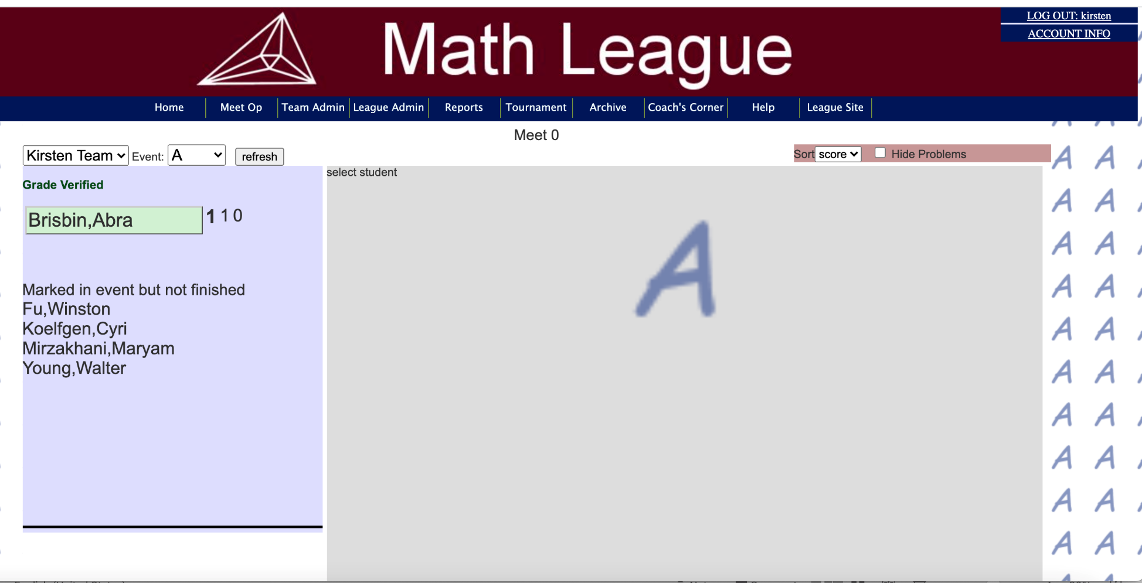
All the students that took test A show up in
a green box. Click on each student
in turn and Verify score
Indication of a potential problem

Slide 6
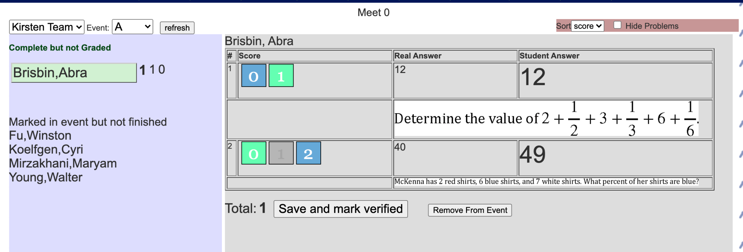
Click on student’s in green. If it is correctly graded,
click Save and Mark Verified. If something is amiss,
email the League and we will investigate.
Take screen shots of problems.
Worth 1 point
Right answer
Student answer
Worth 0 points
Right answer
Student answer
Remember!

Slide 7
Verify scores for each student

Slide 8
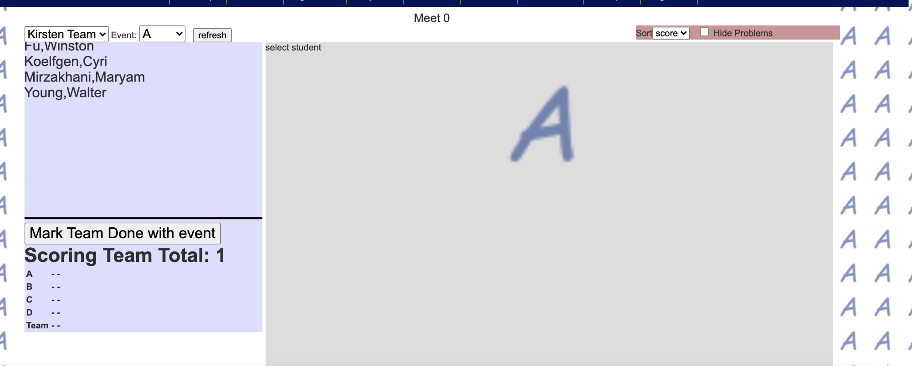
A critical step, often missed last year.
Once done verifying all scores for event A,
scroll down in the left window.
You’ll see Mark Team Done With Event.
Click that!
Click on this

Slide 9
Similarly, verify events B and C.
Always remember to scroll down and
Mark Team Done with Event

Slide 10
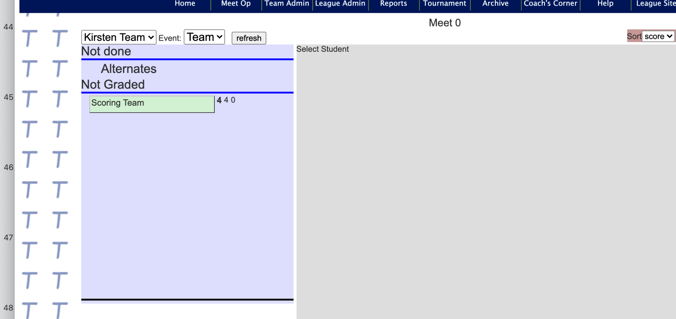
Verify the team event in the same fashion

Slide 11
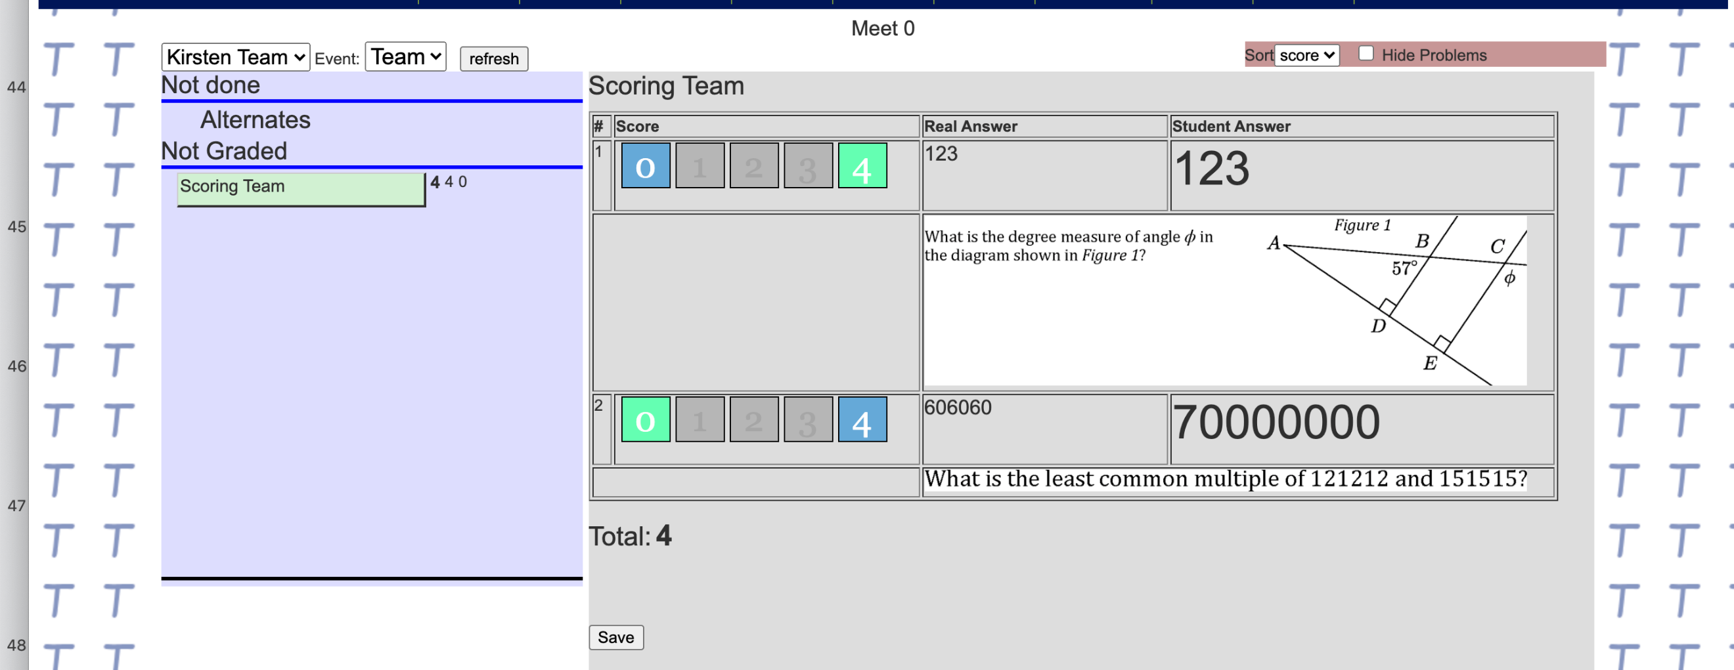
Click Save when done
Team questions are 4 pts each
Click!

Slide 12
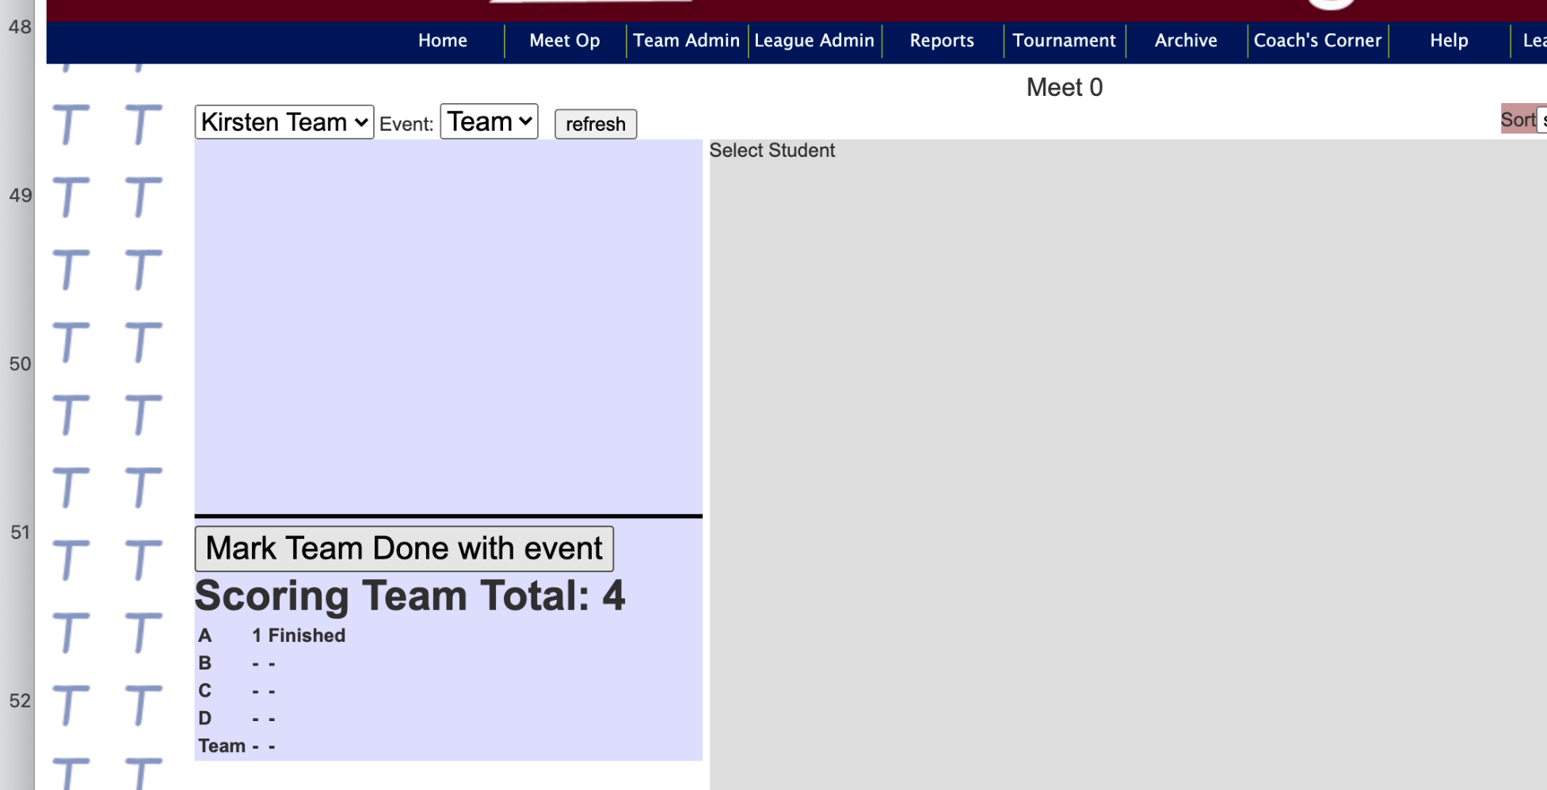
Scroll down the left side,
you have to Mark Team Done With Event.
You may notice you forgot to mark the other events!
I forgot to do Events B,C,D

Slide 13
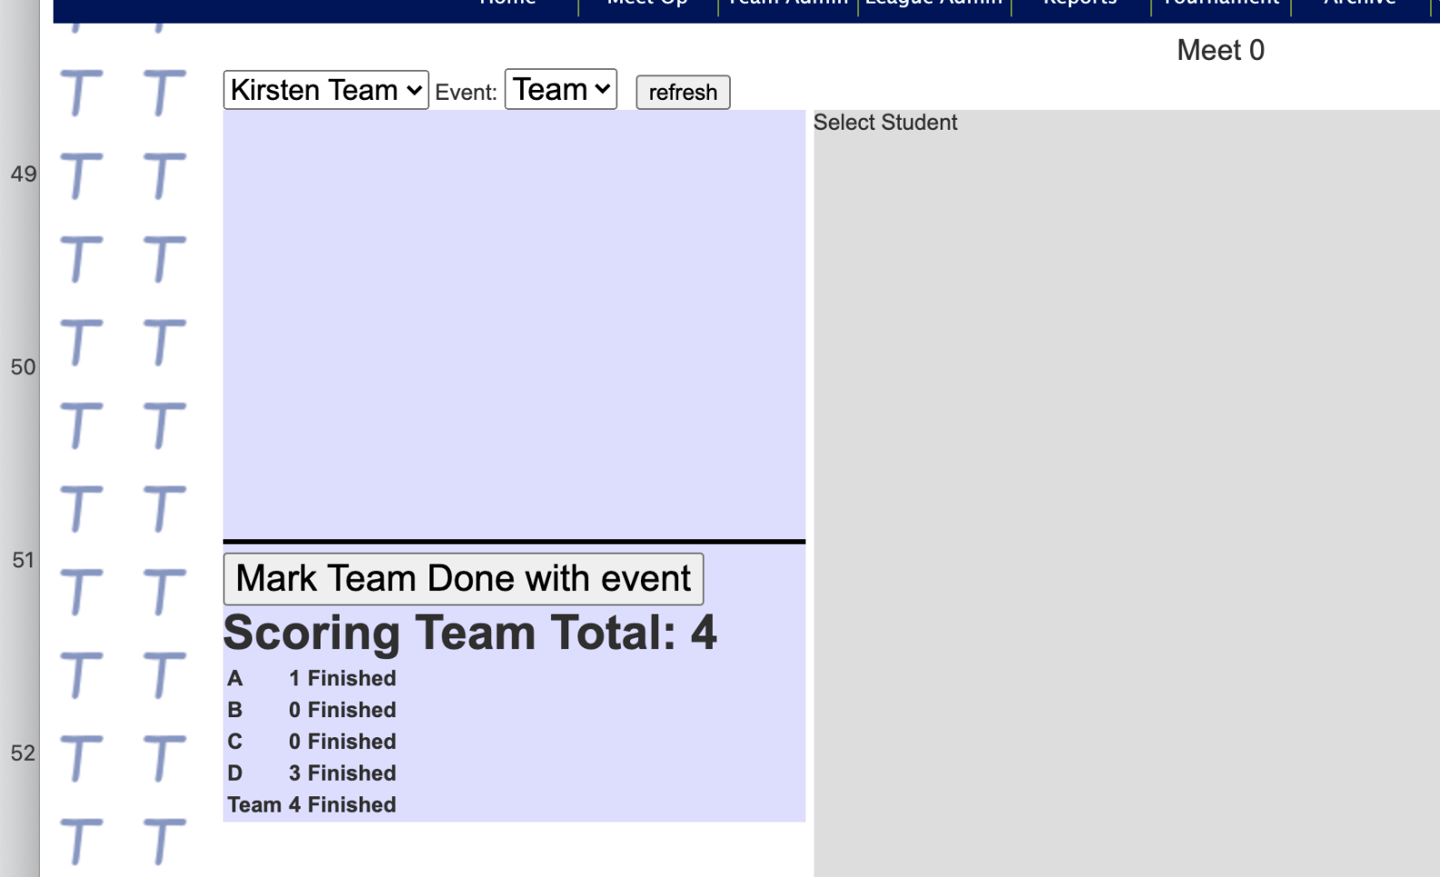
If all is done correctly,
all the events should say Finished
Go back and do Events B,C,D

Slide 14
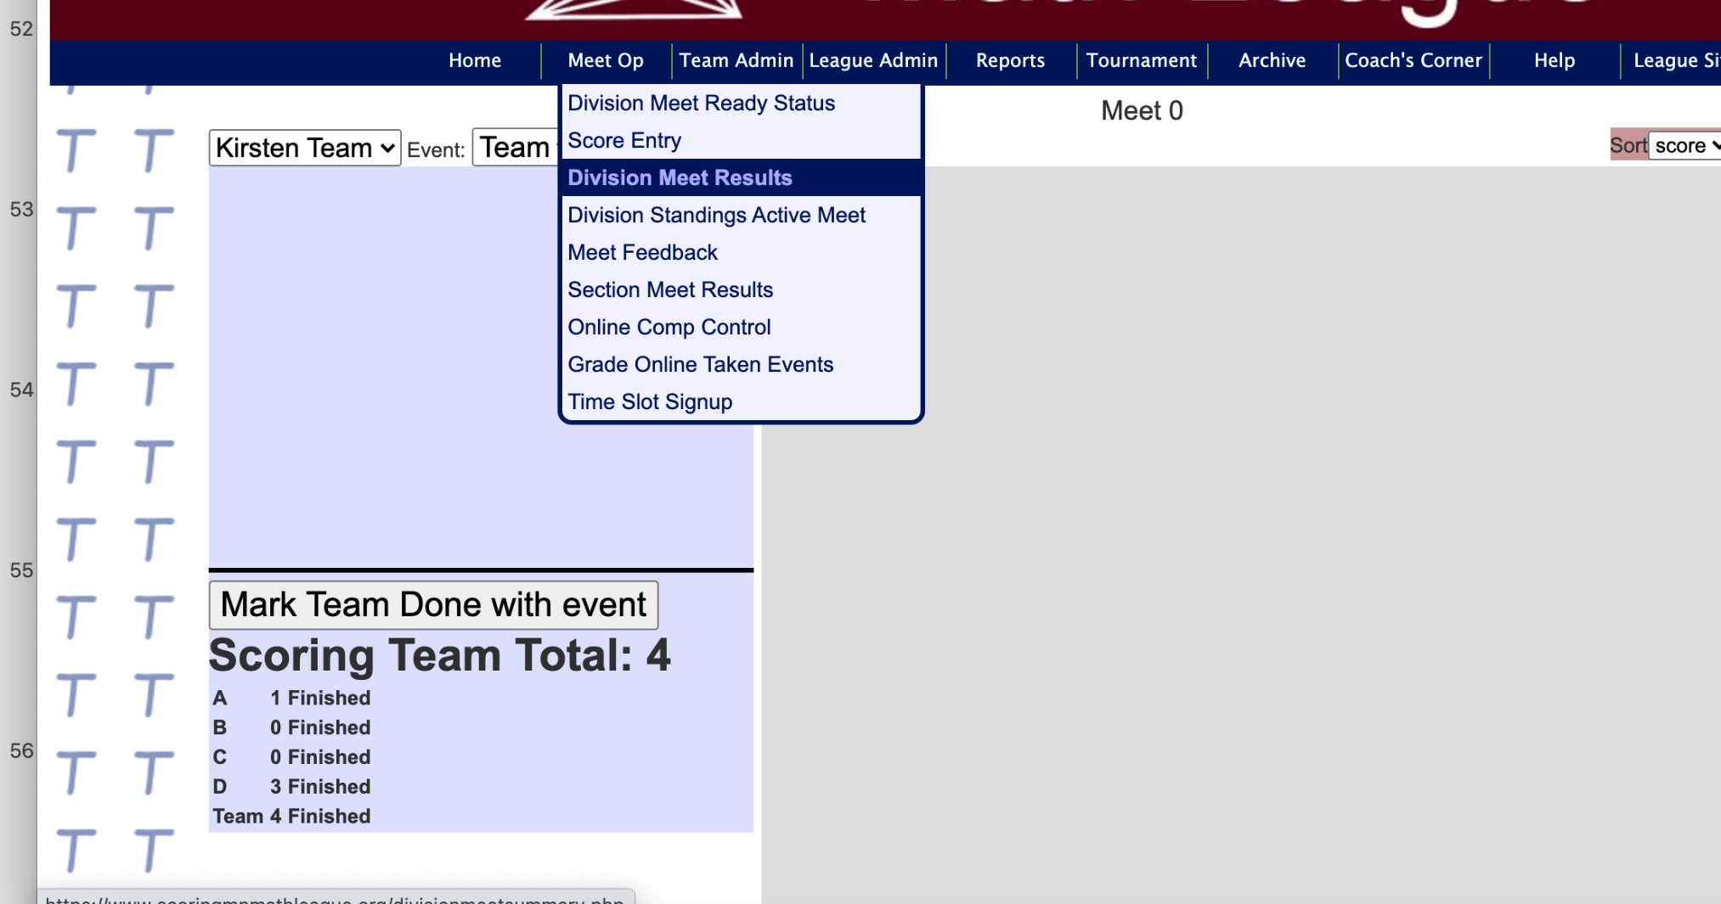
To double check, go to Division Meet Results

Slide 15
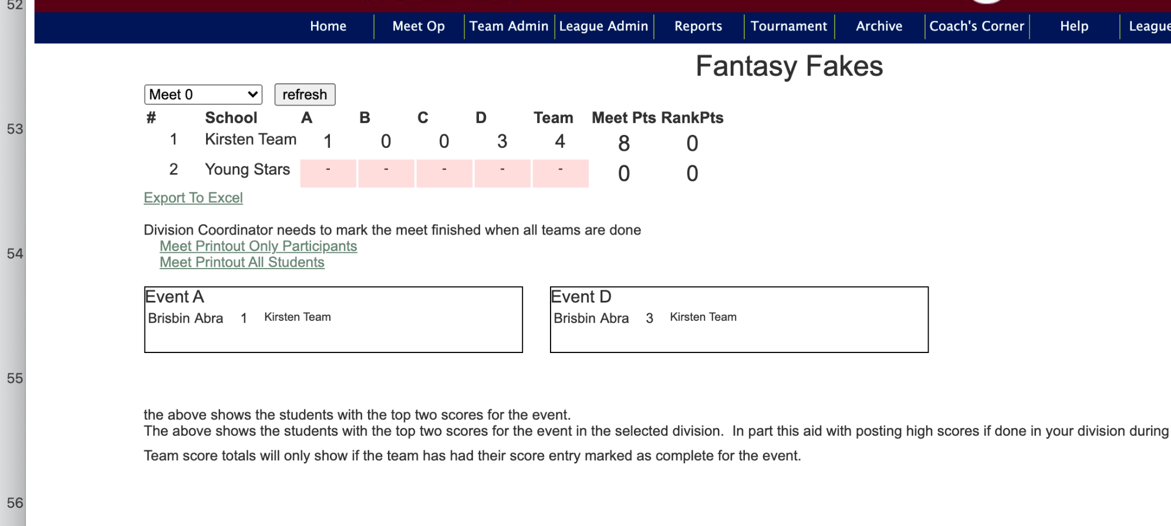
Your score should show up

Slide 16
You’re done
Unless you want to do the Practice test again

Slide 17
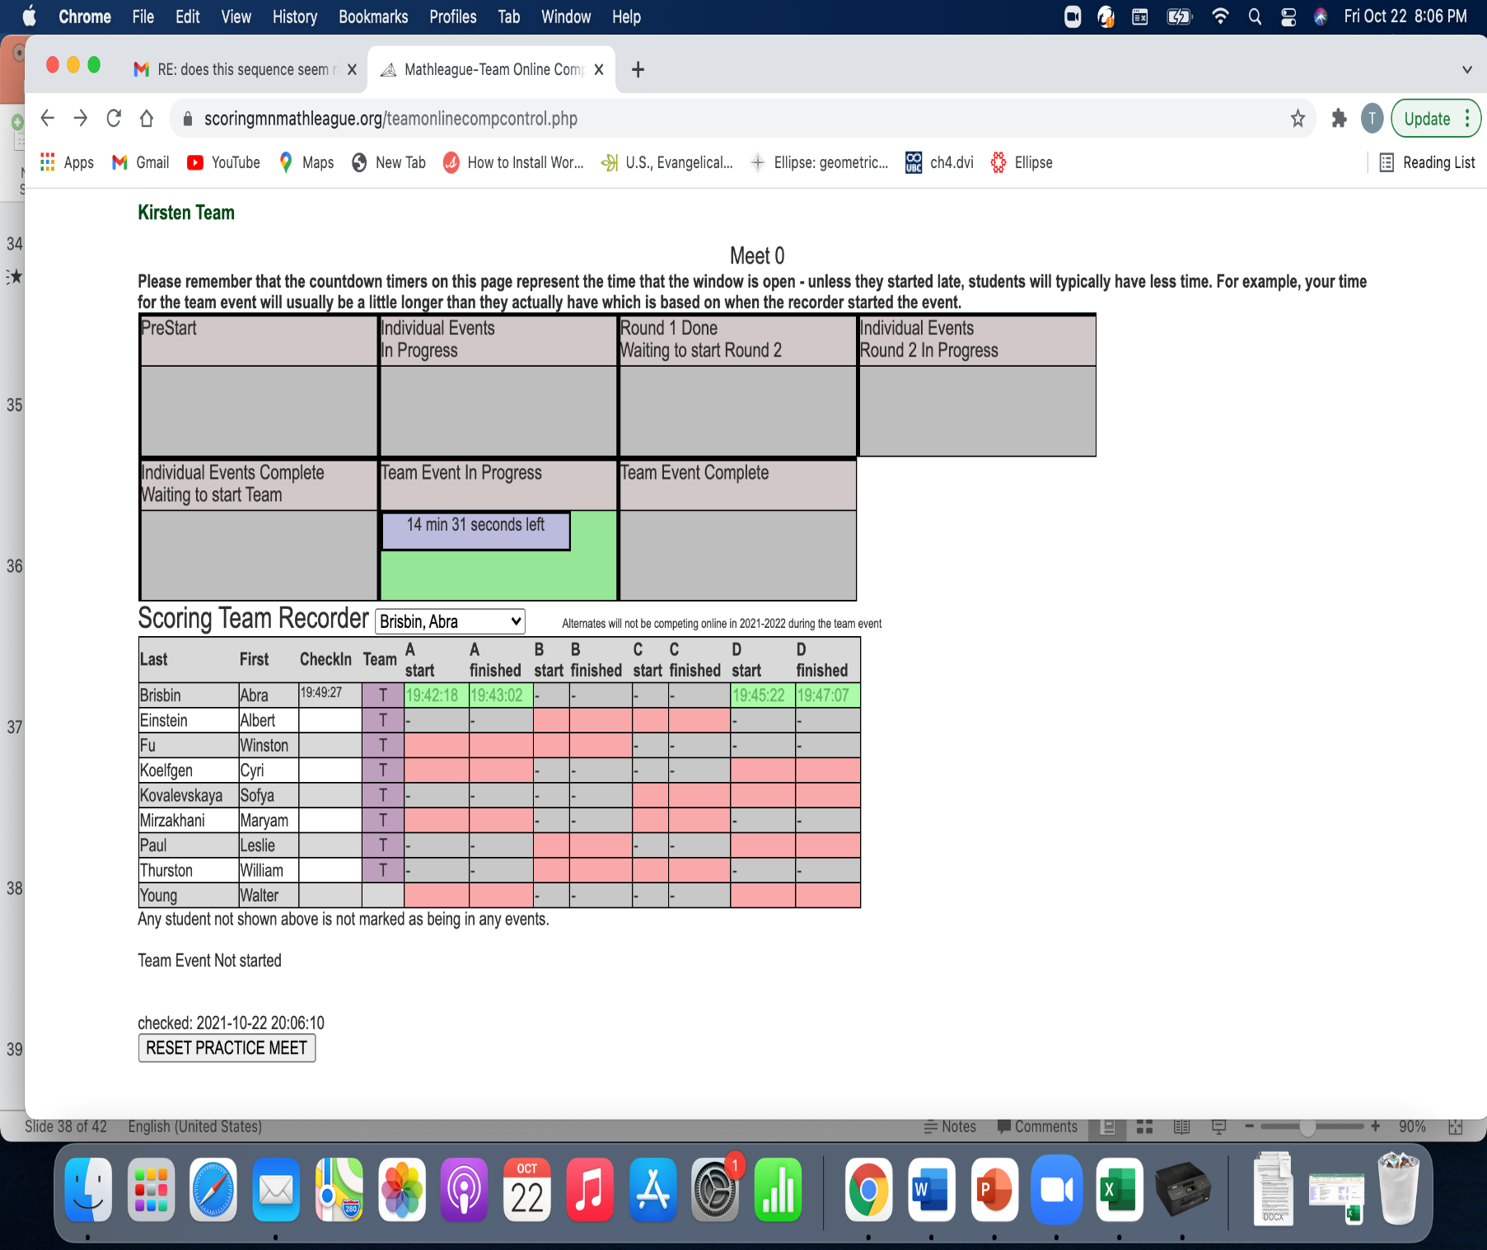
Click Reset Practice Meet and you can do it all again!

Slide 18
Create a Culture of Coolness

